Slide 1
Focus Week: Coping with Lockdown #3

Slide 2
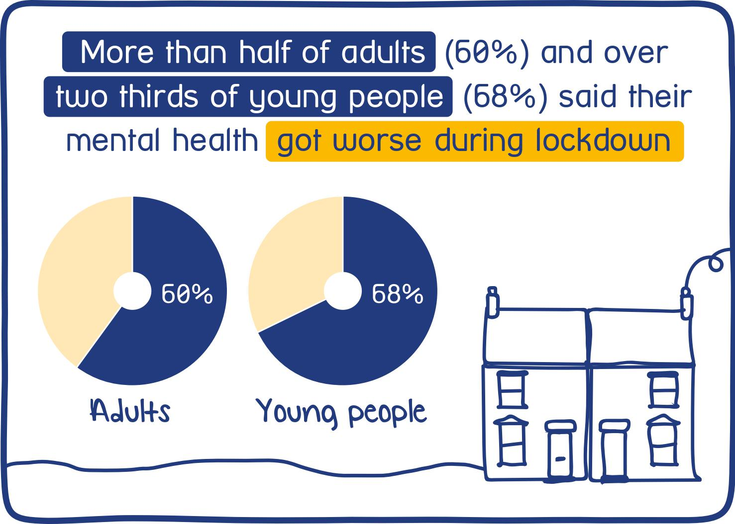
Focus Week: Coping with Lockdown #3
We know that in the first lockdown many young people (and adults) found it really tough. The majority of people said that they felt that their mental health had declined

Slide 3
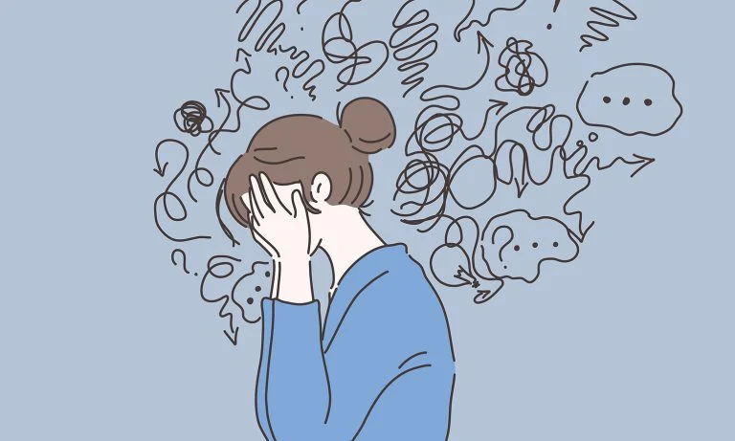
Focus Week: Coping with Lockdown #3
After a really difficult 2020 many of us had hoped that 2021 would be much better. However, the decision to have a third national lockdown and close schools until at least February has come as quite a shock.
Yet again, it shows that some things are completely out of our control and for many of us that can leave us feeling very uneasy.

Slide 4
Focus Week: Coping with Lockdown #3
It’s hard to imagine that this lockdown will be any less easy just because we’ve done it before. However, identifying the challenges we may face and having a plan of action to deal with it is a good start.
Challenge 1: Increased anxiety
You might find yourself worrying more than usual about things. Whether it’s worrying about the virus itself, school, family members and friendship groups.
TOP TIPS:
Get enough sleep
Exercise
Take time out
Learn some breathing exercises https://www.youtube.com/watch?v=5DqTuWve9t8
Cut out stimulants from your diet
Do something that you enjoy
Share your feelings with someone and talk it through
Learn mindfulness https://www.youtube.com/watch?v=inpok4MKVLM

Slide 5
Challenge 2: Sleep dysregulation
Focus Week: Coping with Lockdown #3
Sleep experts have agreed for many years that the optimum time for teenagers to go to bed is around midnight but that they should wake at 11:00am. The school system has regulated teenagers sleep differently but in the last lockdown many teenagers became almost completely nocturnal. You need to strike a balance.
TOP TIPS:
Get enough sleep - 9.5 hours per night
Go to bed and wake at the same time each day
Reduce screen time before bed
Do not consume caffeine before bed
Do not eat too much before bed
Do plenty of exercise
Keep your room tidy and uncluttered
If you’re doing your school work in your room don’t leave
it out overnight
Develop a bedtime ritual and prepare for sleep
(47) Sleep: A bedtime story - YouTube

Slide 6
Challenge 3: Lack of routine
Focus Week: Coping with Lockdown #3
The school day forms a constant routine. Close school and it’s all too easy for those routines to disappear really quickly.
TOP TIPS:
Go to bed an wake at the same time each day
Get washed and dressed as soon as you get up (don’t lounge
in PJs all day)
Eat at the same time (or thereabouts) each day
Build exercise into your daily routine
Block calendar your work. Work for 50 mins then break
for 20 mins
Set yourself clear start and finish times and stick to it
Create to do lists in order to manage your work

Slide 7
Challenge 4: School work
Focus Week: Coping with Lockdown #3
The school work is building up on SMHW and you’re getting overwhelmed. You can’t maintain your concentration and lack motivation. The more behind you get, the more you’re worrying but the less inclined you feel to do it.
TOP TIPS:
Get enough sleep to help concentration
Block out time when you’ll work and stick to it
Remove other distractions; leave your phone in a different room
while you work
Create to do lists. Do your work in order of priority based on deadlines
Drink plenty of water (aids concentration)
Speak out and don’t bury your head in the sand. If you’re getting behind contact your teacher. They will come up with a plan to help you out

Slide 8
Challenge 5: Diet
Focus Week: Coping with Lockdown #3
Many of you may be having to prepare your own food if your parents aren’t around. Or it might be that you are developing a routine different to the rest of the household so you’re eating at different times.
TOP TIPS:
Maintain a healthy balanced diet
Reduce your sugar and caffeine consumption
Get up and have breakfast
Eat at similar times each day
Avoid unhealthy snacking Staying healthy | Childline

Slide 9
Focus Week: Coping with Lockdown #3
Challenge 6: Exercise
Make sure you’re getting out and about every day for some fresh air and exercise. As it stands there’s no limit on how much exercise you can do but team sports are banned. You can also meet up with one other person. Though clearly if they’re from outside your household you need to socially distance. Here’s why exercise is so good for you:
(47) How Exercise Affects Your Body and Mind - YouTube
TOP TIPS:
Build exercise into your routine
Get up and walk away form your work area regularly
Take advantage of the daylight; there’s flexibility with your school
commitments to do exercise in the middle of the day if you wish.
Aim to do 30 minutes of exercise a day as a minimum
You could do PE with Joe Wicks
https://www.youtube.com/channel/UCAxW1XT0iEJo0TYlRfn6rYQ

Slide 10
Focus Week: Coping with Lockdown #3
Challenge 7: Personal space
The entire household is working from home and you’re getting under each others feet. You’re spending so long in each others company that you feel that you have no personal space.
TOP TIPS:
Spend time on your own - have a place within the house that you can retreat to
Go for walks on your own
Value each others privacy
Recognise when things are getting tense and be sensitive to it. Be prepared to keep calm and remove yourself from the situation
Learn to control your emotions even when you’re feeling really angry

Slide 11
Focus Week: Coping with Lockdown #3
Challenge 8: Social interaction
You’re missing your friends and you’re desperate to see them in person. You’ve got SnapChat but it’s not the same.
TOP TIPS:
Keep in regular contact
Come up with novel ideas to entertain yourselves. Have a Netflix party!
Don’t exclude people
Be kind to each other
Offer each other support and check-in on each other
Be responsible; making nasty comments might be even more harmful and hard to cope with under the current circumstances
Report any instances of bullying

Slide 12
Focus Week: Coping with Lockdown #3
Challenge 9: You don’t feel safe
Not everyone has a happy homelife and being in lockdown may expose you to the threat of abuse.
TOP TIPS:
Contact your tutor or somebody in school The student support team is always there to help you.
Childline Childline | Childline
NSPCC NSPCC | The UK children's charity | NSPCC
Stop it now Home - Stop It Now
If you’re in immediate danger contact the Police

Slide 13
Focus Week: Coping with Lockdown #3
Challenge 10: I feel worse than just a bit down
We all feel emotional ups and downs. But if you are worried about your mental health you may need to get help.
TOP TIPS:
Investigate your feelings and symptoms. Feelings and symptoms (youngminds.org.uk)
Talk to someone you trust
Visit your GP
Contact an organisation that’ll help. Again, school is always there for you. If in crisis use the following links:
Get urgent help (youngminds.org.uk)
Get Support | Childline
Mental Health Helpline for Urgent Help - NHS (www.nhs.uk)

